Slide 1
The NYC Taxi CRISIS – Week ii
Group 7
Haardik Sharma
Harsha Chandar
Yogesh Reddy

Slide 2
Recap of Week 1
The Yellow cab crisis
Tipping Behavior Analysis
Reverse Geo tagging

Slide 3
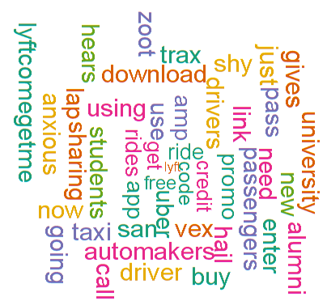
Competitor analysis – LYFT

Slide 4
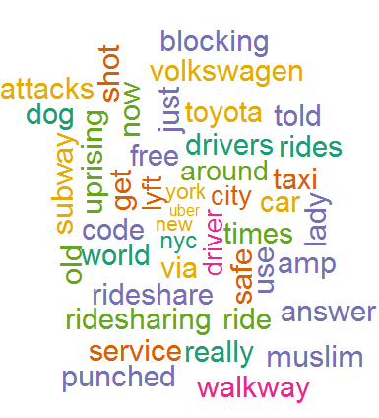
Competitor analysis – UBER

Slide 5
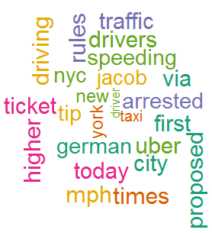
SENTIMENT ANALYSIS – NYC TAXI

Slide 6
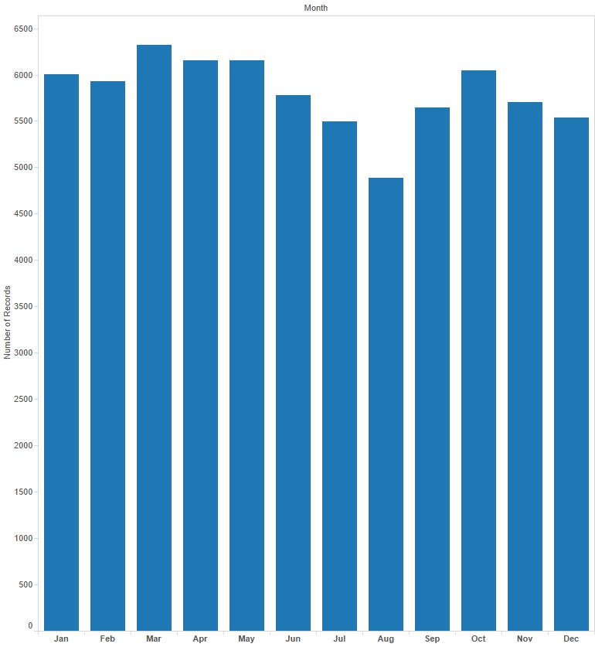
TRIP TREND - 2013

Slide 7
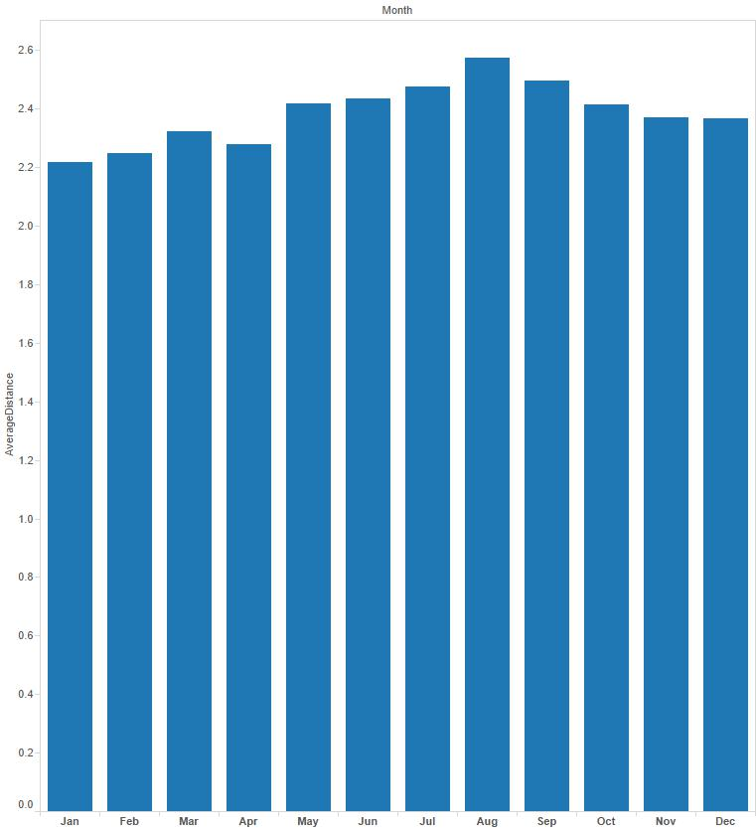
AVERAGE DISTANCE TREND - 2013

Slide 8
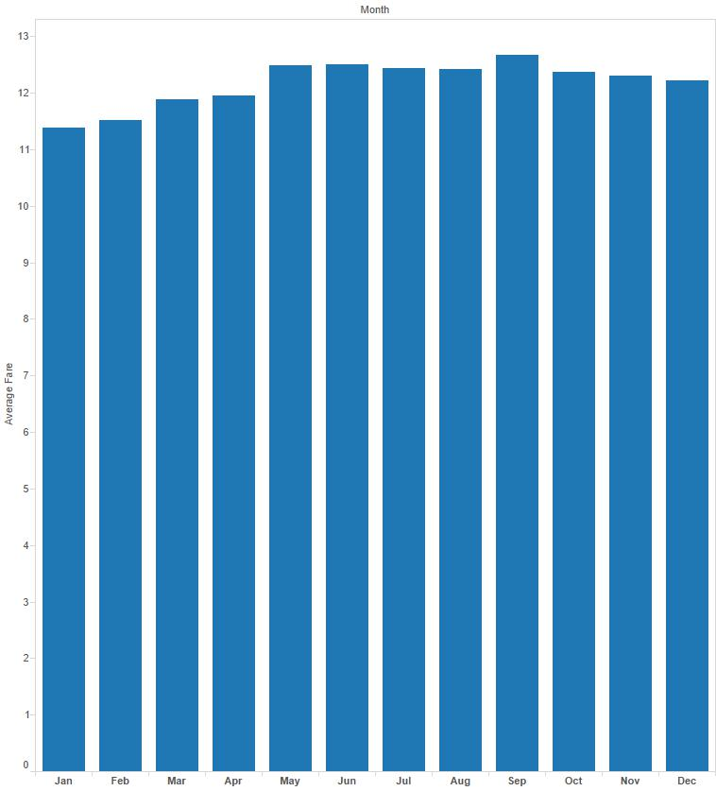
Average fare in 2013

Slide 9
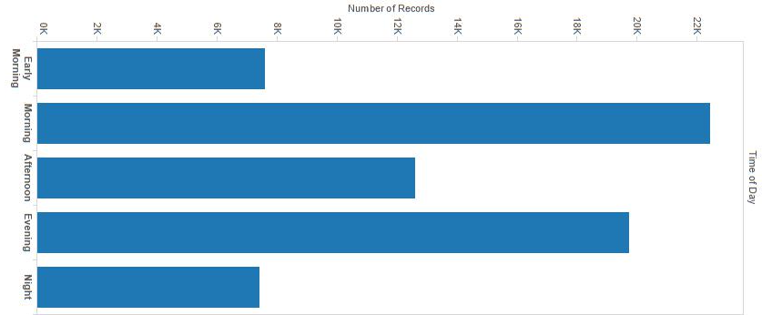
Trip trend across A day

Slide 10
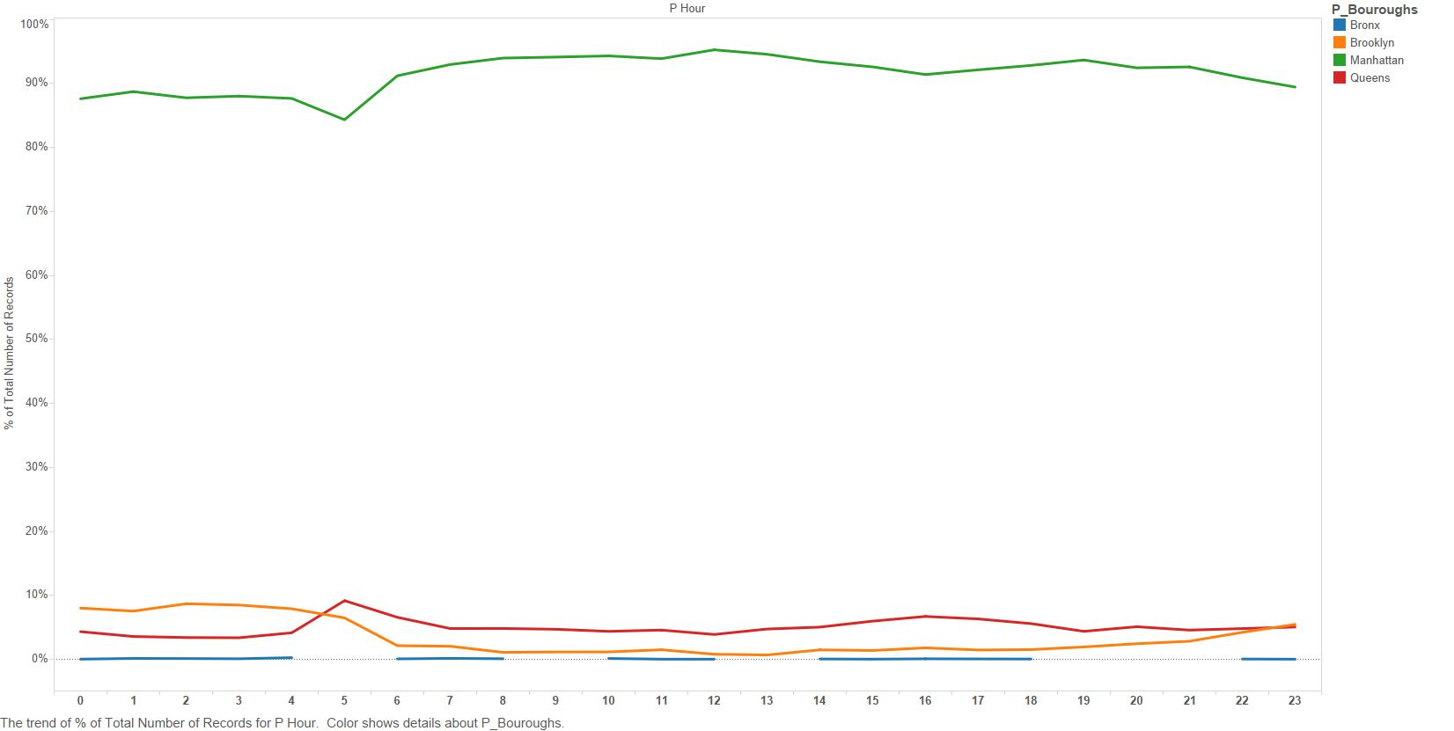
% of traffic vs time hour

Slide 11
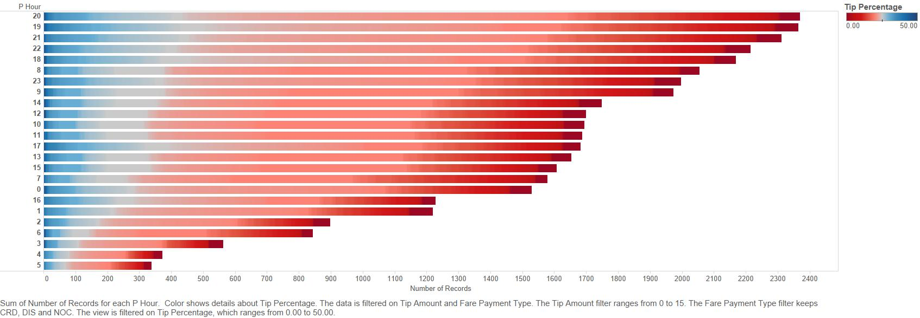
Tipping vs time hour

Slide 12
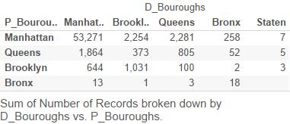
Boroughs

Slide 13
Next Steps
Perform Sentiment Analysis with more data.
Find out appropriate Weather Data Source.
Explore AWS for big data
Explore Tourist behaviour

